Slide 1
Pitch deck
Mark Chung
Notes:
Financials
Deck (send over)
- User profile for interviews and profiling
- Who is the customer - Customer list - Hongtai

Slide 2
ABOUT US
The vision is to accelerate sustainability
The mission is to drastically mainstream ESG reporting by making it easy to compare and understand metrics and frameworks
Notes:
Not necessary for deck.
Vision is broader, higher level than mission
Cover slide, followed by traction slide
Need to get people believing in the story…state problem, meet CHEWIE (solution)

Slide 3
Problem definition

Slide 4
The FIRST step in ESG Reporting is collecting data
How are these metrics being calculated?
Where can I find peer data?
How do I benchmark my organization against others?
ESG Data
How do I find internal and external data for my reporting?
Which metrics are relevant and which ones are not?
How do I know which companies to compare to?
Notes:
Data Levels:
Emissions (compare company to regional calculations
Water contaminants wastewater
Federal, state, local
F.A.I.R principal

Slide 5
Process is ambiguous, time consuming and error prone
Data collection and research is cumbersome, consuming a significant amount of time
This is because the data is not standardized and ESG reporting frameworks are numerous
Users spend too much time digging through reports to scrape data and reading through framework to understand calculations

Slide 6
Use Case Example A
Who: ESG Director or Analyst at publicly-traded company responsible for writing their annual ESG report
Objectives: (1) Collect competitor ESG data (2) Collect internal and external data needed to compare report ESG (3) Identify risks and opportunities (4) Create visuals and compelling story on how company compares. (5) Stay on top of all relevant news and developments.
Detailed Process:
Collect competitor/peer ESG data and understand metrics and methodologies used
Summarize this information so digestible to management
Choose metrics and frameworks to suggest in ESG report
Collect internal and external data needed to put report together
Monitor changes and updates in ESG news
Federal, state, and municipal ESG news
Latest analysis or thought pieces on ESG
Latest changes in regulation and attitudes
Company announcements on their ESG plans and practices
How climate change is impacting how finance and insurers think about lending and insuring
What your climate and ESG risks are, how they’re involving, and how to get ahead of mitigating these risks.

Slide 7
Use Case Example B
Who: Small-to-mid sized private company executive who is aware of the importance of ESG, but doesn’t have a team of people dedicated to it but might, at the very least, have to benchmark themselves to peers. Ultimately may be obligated to report these.
Objectives: (1) Collect peer ESG data (2) Collect internal and external data needed to compare report ESG (3) Identify risks and opportunities (4) Create visuals and compelling story on how company compares. (5) Stay on top of all relevant news and developments.
Detailed Process:
Collect competitor/peer ESG data and understand metrics and methodologies used
Summarize this information so digestible to management
Choose metrics and frameworks to suggest in ESG report
Collect internal and external data needed to put report together
Monitor changes and updates in ESG news
Federal, state, and municipal ESG news
News and analysis

Slide 8
What the prospective customers say….
Data collection is cumbersome
75% say ESG reporting process takes at least 6-10 months
Too much time consumed in data collection (from numerous third-party sources) and processing
Comparative analysis must be done, but data difficult to find
Need to quickly summarize reports
Need to quickly find information. (e.g. latest on regulation, relevant news and headlines). Filter out essential information from the noise.
Notes:
1-3 slides max on how it works
Business fundys afterwards
Prospective customer feedback

Slide 9
solution

Slide 10
Typical Process for Use Cases
1a. Collecting and analyzing external data
2. Researching solutions
3. Feasibility, cost, and risk, assessments
1b. Collecting and analyzing internal data
Provide latest in research and analysis
Assist in first order analysis
Automatically collect and process relevant data
Internal stakeholder initial approval
4. Report on solution options
Generate reports based on data and analysis
Approve?
No
Yes
6. Community engagement
Approve?
No
Yes
Assist in community engagement process
Refine strategy
7. Implement Strategy
8. Collect data
9. ESG reports
Automatically collect and process data
Automatically generate reports
In scope activity
Out of scope
MVP
Notes:
Could be an initial slide at top of deck. Leave out arrows/diamonds.
Boil this down into a simpler slide, solution with CHEWIE
Visuals: funnel. Find a better analogy
ESG data collection/processing -> data analysis -> data reporting
Unsure of MVP – unsure of access to company data because not sure what we’ll be getting. Feel like we need to earn their trust first before gaining internal access.
-- Turn this into a concrete example
Should one of these be a single selling point? Be more explicit in this example.
How does this process get optimized by existing users?
Which one is an easier selling point? Break down further into a flow diagram

Slide 11
The Solution
Updates to regulation and relevant news
Third-party ESG data
ESG framework methodologies
Other relevant data sources
Singular, harmonized dataset that can be used to compare companies’ ESG performance and normalized flow of information
Notes:
One-stop shop for ESG “assessment”, “XXX”?

Slide 12
PROBLEM DEFINITION recap
MARKET GAP
Isn’t a product on the market like this. ClarityAI has similar data but caters to investors and portfolio managers only. ContinueAI has made an announcement to “collect millions of data points and navigate the ESG cycle from start to finish”. S
CUSTOMERS
ESG reporting teams or individuals within companies required to or who voluntarily disclose ESG metrics
Addressable market*
There are ~6,000 publicly traded companies in the U.S. and ~120,000 U.S. private companies of between 100-500 employees.
COSTS
Reduce time and cost in data collection, information gathering, and benchmarking.
*Note: If the addressable market includes private companies, market opportunity drastically expands
Notes:
Note: Reporting software names

Slide 13
SOLUTION recap
CLOSE THE GAP
TARGET AUDIENCE
Not currently a data service that allows quick, easy data collection and benchmarking
Public and private organizations required to disclose or voluntarily disclosing ESG metrics
COST SAVINGS
SIMPLE TO USE
Reduced cost and time related to conducting data gathering, research, and benchmarking
Normalized data and information flow

Slide 14
COMPANY OVERVIEW

Slide 15
BUSINESS MODEL subscription basis by user type
basic
Access to all ESG data, methodologies
INTERMEDIATE
Everything in Basic plus access to visualization tool and ESG related news

Slide 16
MARKET OVERVIEW
$60 MILLION
$150 MILLION
$300 million
10% of market
25% of market
50% of market

Slide 17
Market comparison
$58m
$288M
Extreme competition
expansion
10% of TAM.
Wildly successful. Gain 50% of TAM.

Slide 18
OUR COMPETITION
DecarbX
COMPETITORS
Our product is priced below that of other companies on the market
Design is simple and easy to use, compared to the complex designs of the competitors
Ease of use and fast data collection are the main draws for our consumers to our product
Continue AI

Slide 19
Start with individual process, enabling Expansion into enterprise solutions
Integrate this knowledge into enterprise-wide, integrated solutions
value
Foundation has been built with best-in-class knowledge
Relative market size
time

Slide 20
Our competition
Convenient
DecarbX
Clarity AI
Continue AI
Affordable
Expensive
Sustainlytics / MSCI / Morningstar
Inconvenient
Notes:
Customer type: owner of or senior person in companies (small and medium) looking to grow, get access to capital or sell.
Chief sustainability officers. Chief Operation Officer. CFO to a degree.

Slide 21
Growth strategy
Y0M6 – After seed round
Roll out beta to select number of invited users
Y0m12
Release the MVP to the general pubic
y1m6
Conclude gathering of feedback and start next iteration process of refinement

Slide 22
TRACTION
Forecasting for success
Key Metrics
 | Clients | Orders | Gross revenue | Net revenue
Year 1 | 100 | 200 | $240,000 | -$1,852,000
Year 3 | 400 | 800 | $1,440,000 | -$2,030,000
Year 5 | 1,600 | 3,200 | $7,680,000 | $3,000,000
Year 7 | 4,800 | 9,600 | $23,040,000 | $17,820,000
REVENUE BY YEAR

Slide 23
TWO-YEAR ACTION PLAN
Hiring
Plan Review
by Advisors
BUILD / TEST PROTOTYPE
RUN FOCUS GROUPS
(can start before this)
SEED FUNDING
2024
JAN
FEB
MAR
APR
MAY
JUN
JUL
AUG
SEP
OCT
NOV
DEC
2025
JAN
FEB
MAR
APR
MAY
JUN
JUL
AUG
SEP
OCT
NOV
DEC
BUILD MMP
REFINE /
SERIES A FUNDING
LAUNCH MVP
LAUNCH MMP

Slide 24
FINANCIALS
 | Year 1 | Year 2 | Year 3
INCOME
Users | 50,000 | 400,000 | 1,600,000
Sales | 500,000 | 4,000,000 | 16,000,000
Average price per sale | 75 | 80 | 90
Revenue @ 15% | 5,625,000 | 48,000,000 | 216,000,000
GROSS PROFIT | 5,625,000 | 48,000,000 | 216,000,000
Expenses
Sales & marketing | 5,062,500 | 38,400,000 | 151,200,000 | 70%
Customer service | 1,687,500 | 9,600,000 | 21,600,000 | 10%
Product development | 562,500 | 2,400,000 | 10,800,000 | 5%
Research | 281,250 | 2,400,000 | 4,320,000 | 2%
TOTAL EXPENSES | 7,593,750 | 52,800,000 | 187,920,000

Slide 25
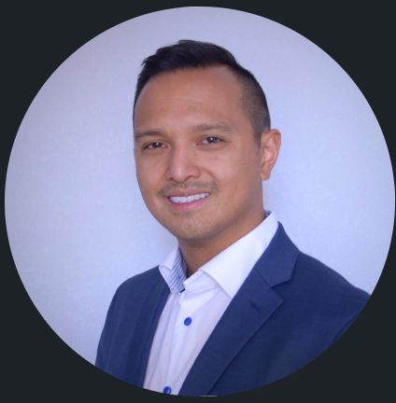
MEET THE TEAM
Mark Chung​
Hongtai Huang
XXX
XXX​
President / CEO
Chief Technology Officer
Chief Financial Officer
VP Marketing

Slide 26
MEET THE TEAM
TAKUMA HAYASHI
MIRJAM NILSSON​
FLORA BERGGREN​
RAJESH SANTOSHI
President
Chief Executive Officer
Chief Operations Officer
VP Marketing
GRAHAM BARNES
ROWAN MURPHY
ELIZABETH MOORE
ROBIN KLINE
VP Product
SEO Strategist
Product Designer
Content Developer

Slide 27
FUNDING
$14,000
$12,000
$82,000
$32,000
ANGEL INVESTMENTS
PROPERTY
SHARES
CASH
Amount obtained through other investors
Revenue obtained from property rentals
Number of shares converted into USD
Liquid cash we have on hand

Slide 28
SUMMARY
At Contoso, we believe in giving 110%. By using our next-generation data architecture, we help organizations virtually manage agile workflows. We thrive because of our market knowledge and great team behind our product. As our CEO says, "Efficiencies will come from proactively transforming how we do business.”

Slide 29
THANK YOU
Mark Chung
303-803-8129
XXX@XXX.com
www.XXX.com

Slide 30
Supplemental

Slide 31
Use Case Example A
Who: Analyst, Associates, or Principal at an investment firm
Objective: Research possible ways to invest in the hydrogen economy and create a thesis on who to invest in, why, and assess the risks.
Process:
Research hydrogen fundamentals.
What is it used for? How is it produced? How it’s transported and stored? What are the technical challenges of transport?
Conduct general research market dynamics.
Who are the major players? Who are the customers? Why would they adopt hydrogen? What are the alternatives? Which are more competitive? Why/why not?
Are there incentives? Funding opportunities? Tax breaks? What are the regulatory hurdles?
Analyze financials or costs
NPV, Levelized Cost, ROI/ROE, Payback period, Debt/Equity, impacts of grants/funding, cash flow analysis, scenario analysis
Risk Assessment
What could go wrong? At what price will one be competitive against another?
Create presentation or paper.
Results ultimately must be summarized in written form

Slide 32
Use Case Example B
Who: Decarbonization Strategist at ExxonMobil
Objective: Propose most cost effective, sustainable way to lower your company’s carbon footprint
Process:
Research renewable energy fundamentals (e.g. solar, wind, hydro, nuclear, geothermal, hydrogen, etc.).
What parts of my business am I electrifying? How many hours of electricity do I need? What are the most cost-effective, high TRL technologies to consider? How much carbon can I offset compared to alternatives?
Conduct assessments and feasibilities of possible solutions and compare to peers.
How will I implement this? What will it cost? What’s the benefit? How can I benchmark to peers? What methods or standards are they using? How do I apply these standards to my problem?
Engage with local stakeholders and assess risks of the solution
What local stakeholder groups do I contact? How do I ensure their needs are met? What frameworks do I follow and what methodologies do I use? What are the risks to my organization for implementation? How do I mitigate those?
Create presentation or paper for internal and external stakeholders
Presentation and memo on top three solutions and why they make sense for ExxonMobil

Slide 33
Use Case Example C
Who: Sustainability Manager at Amazon
Objective: Reduce environmental footprint and operate in sustainable manner
Process:
Developing and implementing sustainability strategies :
This involves setting goals, creating policies, and integrating sustainability into operations and business decisions. Strategies may focus on energy efficiency, waste reduction, renewable energy, green building practices, sustainable supply chain management, etc.
Tracking sustainability metrics:
Sustainability managers measure and report on metrics like carbon emissions, water usage, diversity stats, etc. This helps assess progress and identify areas for improvement.
Coordinating sustainability programs and projects:
Managers oversee facility upgrades, process improvements, employee engagement initiatives, and other programs to make operations more sustainable.
Ensuring compliance with regulations:
Managers stay up-to-date on environmental, social and governance (ESG) policies and regulations to ensure the organization meets legal obligations.
Promoting sustainability within the company culture:
Managers work to drive adoption of sustainability practices throughout the company through training, communications, events and leading by example.
Stakeholder engagement:
Sustainability managers may communicate sustainability performance to shareholders, regulators, customers, local community members and other stakeholders.
Providing expertise and advice:
Managers are resources for technical knowledge on topics like energy management, waste minimization, green procurement, etc.
Notes:
1 or 2 use cases sufficient or put into appendix
2 decks – 1 for pitch and 1 for email (more visuals)

Slide 34
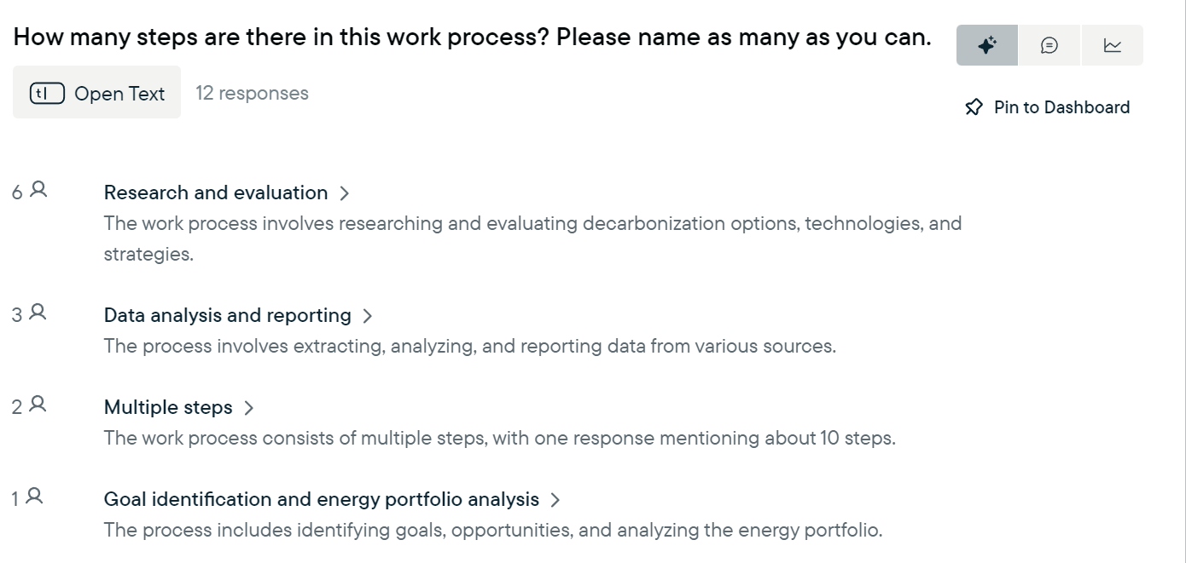

Slide 35
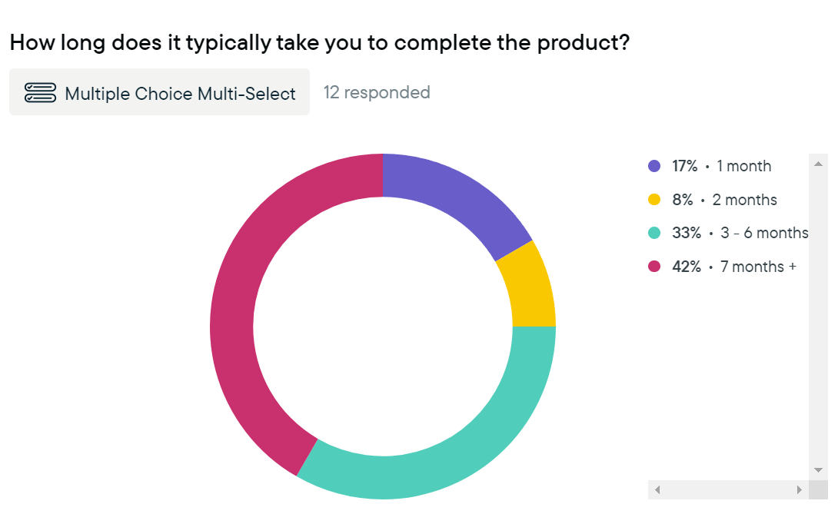

Slide 36
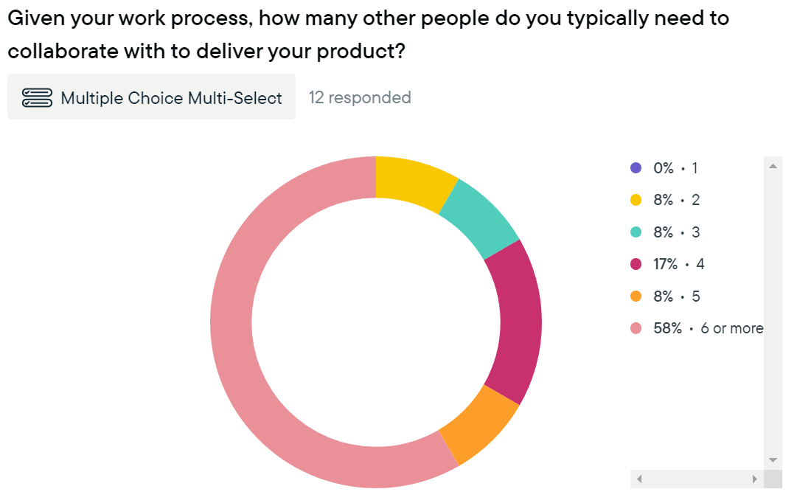

Slide 37
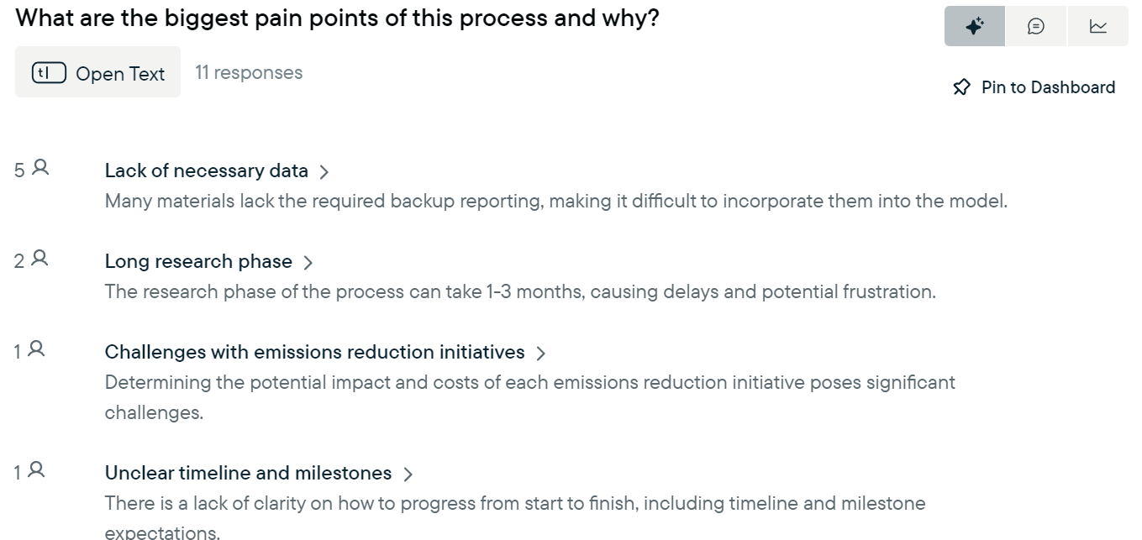

Slide 38
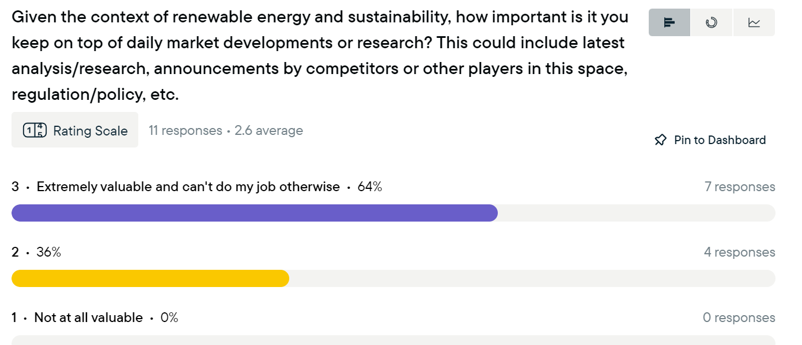

Slide 39
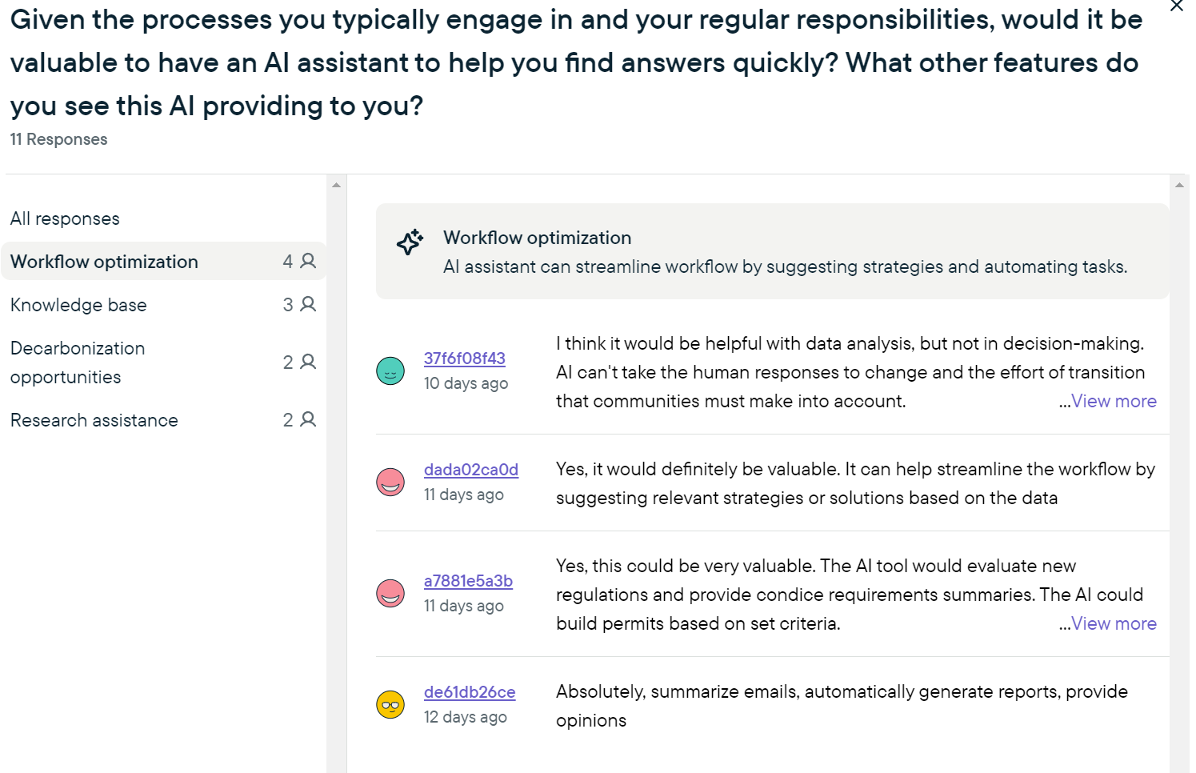

Slide 40
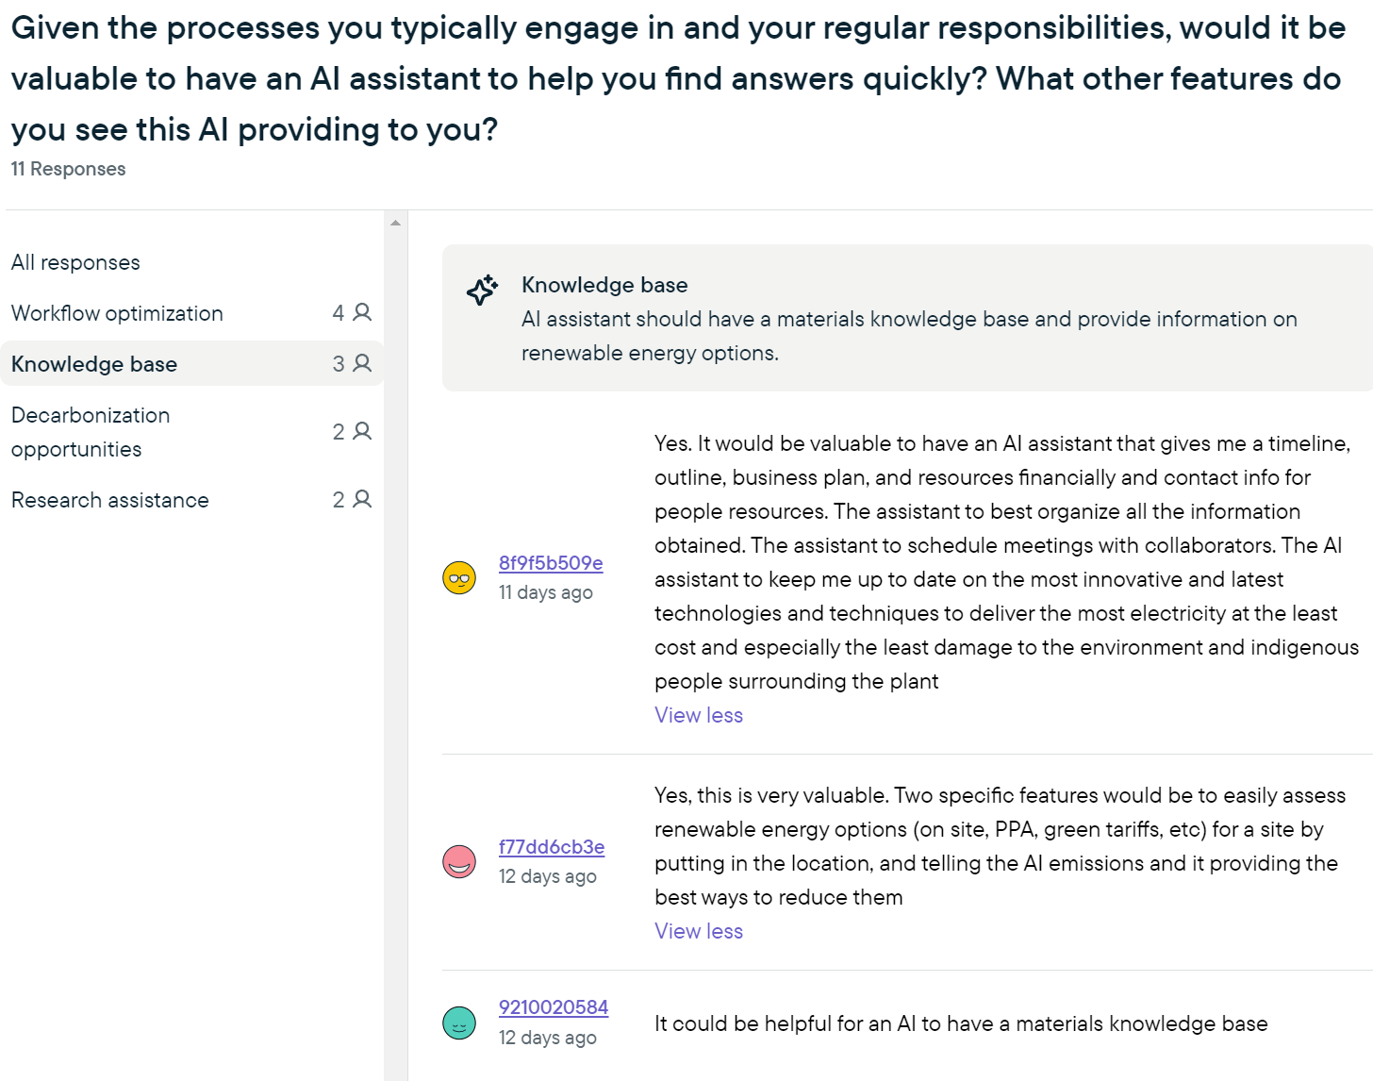

Slide 41
Types of information/data sets that would be useful
What metrics companies report
What is their methodology
What, if any, international standards are being followed
Local rules/regulation
Models to calculate said metrics above
Overview of technologies/methods
What federal, state, and municipal funds available
Who are local stakeholders? Contact information

Slide 42
Other Use Case Examples
Who: Renewable Energy Project Developer at NextEra Energy
Objective: Already has a renewable solution in mind. Needs to assess the data, commercial viability, market conditions, regulatory hurdles, organize a team of engineers to execute and consistently communicate with management on progress.
Who: Retail investor looking to invest in renewable energy stocks
Objective: Understand who the major players are, what their business is, their financial status, what they do, etc.
Who: University student/professor or research scientist
Objective: Conduct literature reviews, understand key concepts at a deep level, find relevant research, produce a paper or presentation.
Common Links: All above use cases must conduct research, collect and analyze large amounts of disparate data, and communicate results with a third party.

Slide 43
Problem definition
Analysis can be time-consuming and burdensome!
Current Uses
General Research / Data Collection
Knowledge Building
Knowledge Recall
Models / Calculations
Cost / valuation
Efficiency / time
Risk Assessment
Operational / Technical / Safety
Financial / Competition / Suppliers
Final Product / Recommendations
Presentation
Written Report
Third-party or internal data, search engines
Third-party or internal models, tools, software
Unique to each problem, but process is the same
User Roles
Researcher
Financial Analyst
A summarization of analysis is required
Market Analyst
Strategy

Slide 44
User Matrix
Usage Frequency
G | B, D | A, H
 | C | E
User Knowledge

Slide 45
Problem Solution – Get to tell the story faster and better
General Research
Knowledge Building
Knowledge Recall
Calculations
Cost
Valuation
Risk Assessment
Operational / Technical / Safety
Financial / Competition / Suppliers
Conclusion/Recommendations
Presentation
Written Report
DecarbX
General Research
Calculations
Risk Assessment
Conclusion/
Recommendation
Roles of SME’s
Researcher
Financial Analyst
Market Analyst
Strategy

Slide 46
Use Case B – Decarb Strategist Flow Diagram
1. Collecting and analyzing data
2. Researching solutions
3. Feasibility, cost, and risk assessments
Internal and third-party
Understanding what solutions exist
Estimating cost, feasibility and impact
Internal stakeholder initial approval
4. Report on solution options
Summarizing findings
Approve?
No
Yes
6. Community engagement
Approve?
No
Yes
Assist in community engagement process
Refine strategy
7. Implement Strategy
8. Collect data
9. Progress reports
Internal and third-party
Continuous reporting on results
In scope activity
Out of scope
Notes:
ESG data collection/processing -> data analysis -> data reporting
Unsure of MVP – unsure of access to company data because not sure what we’ll be getting. Feel like we need to earn their trust first before gaining internal access.
Turn this into a concrete example
Should one of these be a single selling point? Be more explicit in this example.
How does this process get optimized by existing users?
Which one is an easier selling point? Break down further into a flow diagram

Slide 47
Data Sources

